Slide 1


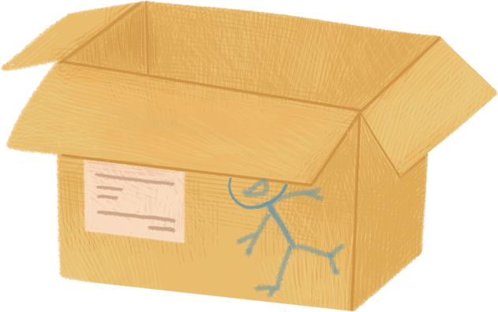


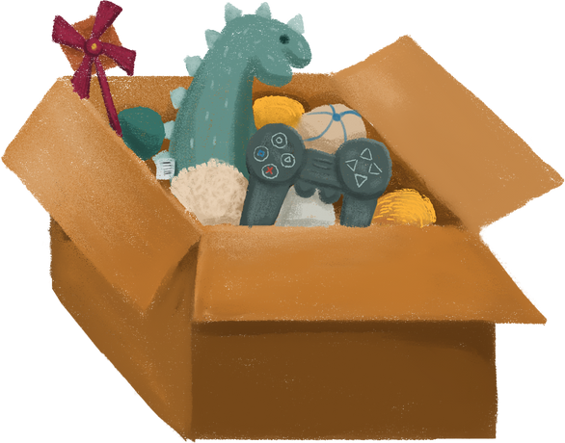

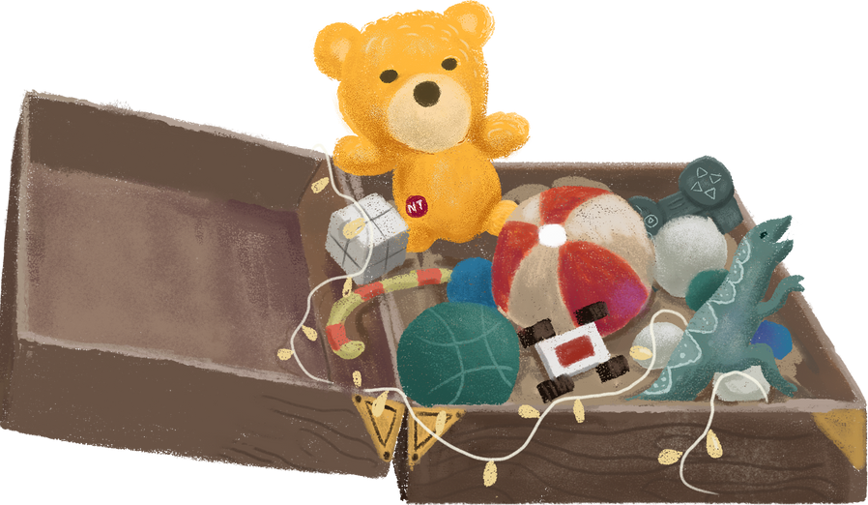



Toys Sales
Report by group E

Slide 2



Agenda
Project Description
Project Objectives
Methodology
Key Findings
Recommendations
Conclusion

Slide 3
Project Description
Toys Co. is a fictitious retail chain company in Mexico that wants to analyze its sales data from January 2022 to September 2023 to identify trends, optimize inventory, and improve decision-making.
The project aims to uncover insights such as top-performing products, seasonal trends, store performance, and forecast sales for the next two months to support strategic planning.

Slide 4
Project Objectives
Using SMART criteria (Specific, Measurable, Achievable, Relevant, Time-bound) to refine objectives:
Analyze sales trends to identify seasonal patterns and optimize promotional strategies.
Identify the top 10 products by sales revenue and profit to prioritize marketing and inventory efforts.
Compare location performance by evaluating revenue contributions across regions to improve strategies.
Examine inventory levels to identify overstocked and high-demand items for better management.
Review product categories to focus on high-performing segments and improve weaker ones.

Slide 5
Methodology
Data Source: Maven Analytics Dataset
Tools Used: Python, SQL, and Tableau
Data Structure: (Details are provided in the next two slides)
Data Analysis Strategy:
Collect Data
Clean and Prepare Data
Exploratory Data Analysis (EDA)
Generate Insights
Report and Visualize

Slide 6
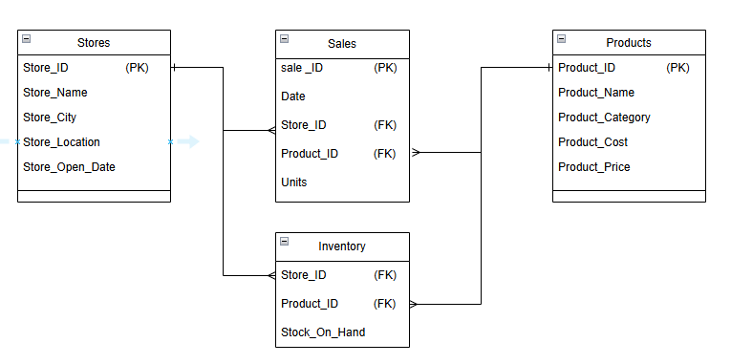
Data Structure

Slide 7
Data Structure
The dataset consists of four tables, as outlined in the ERD:
Stores Table:
5 columns: (Store_ID, Store_Name, Store_City, Store_Location, Store_Open_Date)
50 rows
Sales Table:
5 columns: (Sale_ID, Date, Store_ID, Product_ID, Units)
829,262 rows
Inventory Table:
3 columns: (Store_ID, Product_ID, Stock_On_Hand)
1,593 rows
Products Table:
5 columns: (Product_ID, Product_Name, Product_Category, Product_Cost, Product_Price)
35 rows

Slide 8
Data Cleaning & Preprocessing
We utilized several functions to clean and prepare the dataset, including:
isna(): Identified missing values.
fillna(): Filled in the missing values.
rename(): Altered axes labels.
drop_duplicates(): Removed duplicate rows and fixed column data types.
to_datetime(): Converted the date column from object type to date format.
replace(): Replaced $ in the price column and converted it to float numbers.
Boxplot and quantile were used to detect outliers.
Added Revenue and Profit columns to the sales table for further analysis.

Slide 9
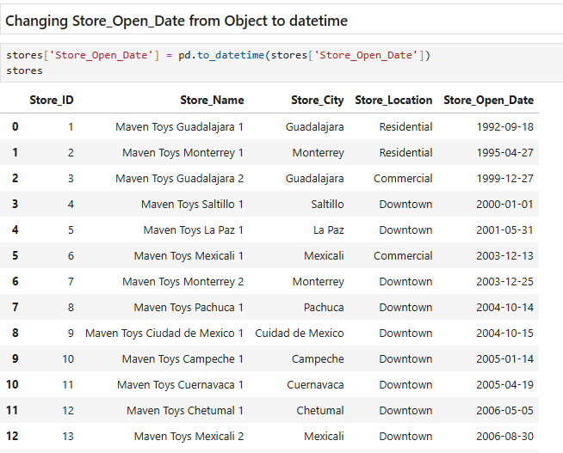
Data Cleaning & Preprocessing
Changing date columns from object to datetime

Slide 10
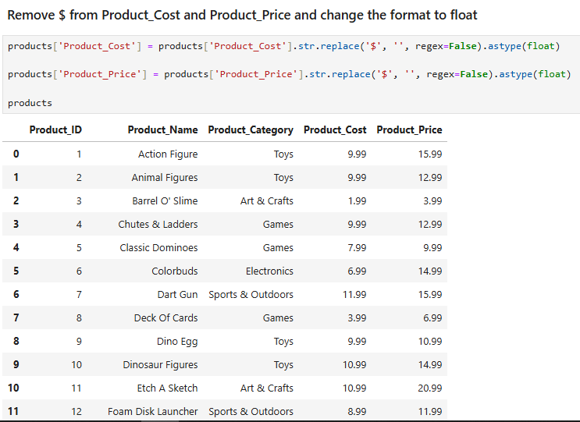
Data Cleaning & Preprocessing
Removing dollar sign from product price and product cost columns

Slide 11
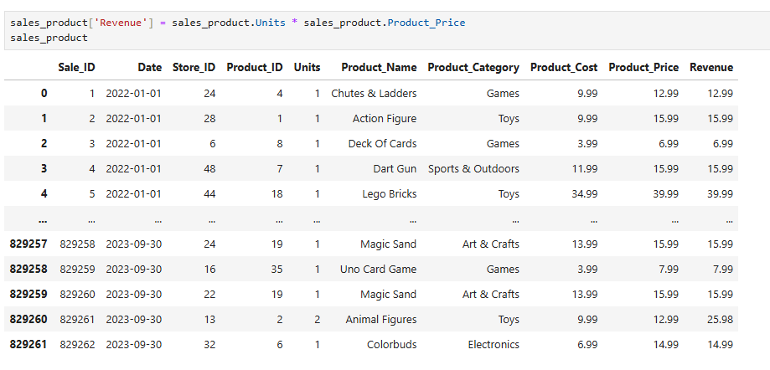
Data Cleaning & Preprocessing
Add revenue column to store table

Slide 12
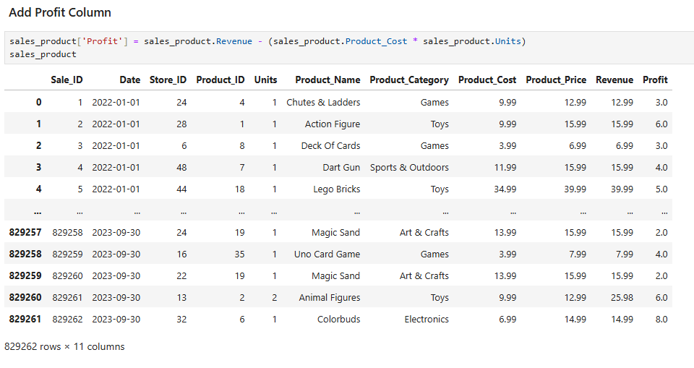
Data Cleaning & Preprocessing
Add profit column to store table

Slide 13
Key Observations
Declining Sales and Profit: Sales decreased by 6.7% (from $7.5M to $7.0M), and profit decreased by 18.2% (from $2.2M to $1.8M).
Category Insights:
Toys remained the top sales category, contributing $2.3M in 2023, despite a $0.5M decline.
Art & Crafts doubled its sales to $1.8M, rising from the smallest to the second-largest category.
Regional Dominance: Downtown locations consistently outperformed, contributing 56% of total sales in 2022 and increasing to 57% of total sales in 2023.

Slide 14
Key Findings
Year-Over-Year Performance
Sales:
2022: $7.5M
2023: $7.0M (-6.7%)
Profit:
2022: $2.2M
2023: $1.8M (-18.2%)
Units Sold:
2022: 549.5K
2023: 541.1K (-1.5%)
Orders:
2022: 420.8K
2023: 408.4K (-2.9%)

Slide 15
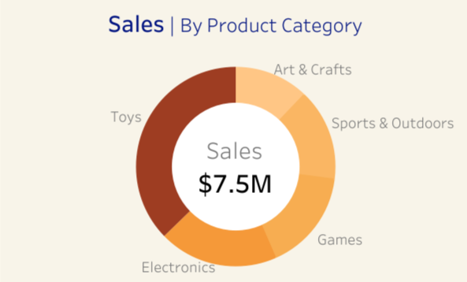
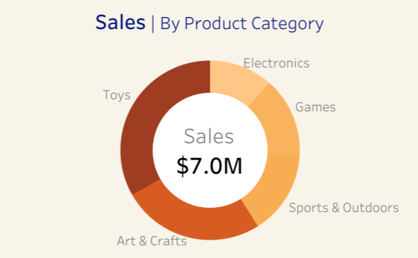

Key Findings
Sales by Category
2022:
Toys: $2.8M (37.3%)
Art & Crafts: $0.9M (12%)
2023:
Toys: $2.3M (32.9%)
Art & Crafts: $1.8M (25.7%)
Insight:
Toys remained the top sales category with a $0.5M decline, while Art & Crafts doubled its sales to become the second-largest contributor.

Slide 16
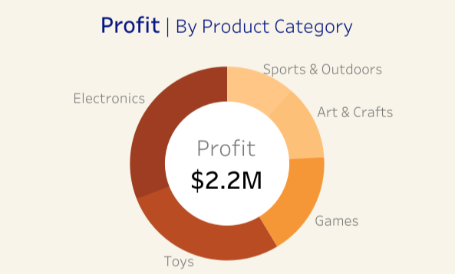
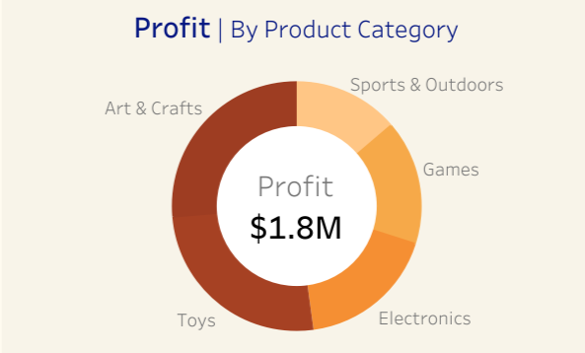
Key Findings
Profit by Category
2022:
Electronics: $674.4K (Top Contributor)
Art & Crafts: $272.9K (Second Lowest Contributor)
2023:
Art & Crafts: $480.4K (Top Contributor)
Electronics: $327.0K (Significant Decline)
Insight:
Art & Crafts overtook Electronics as the top profit contributor in 2023, reflecting
a shift in consumer demand.

Slide 17
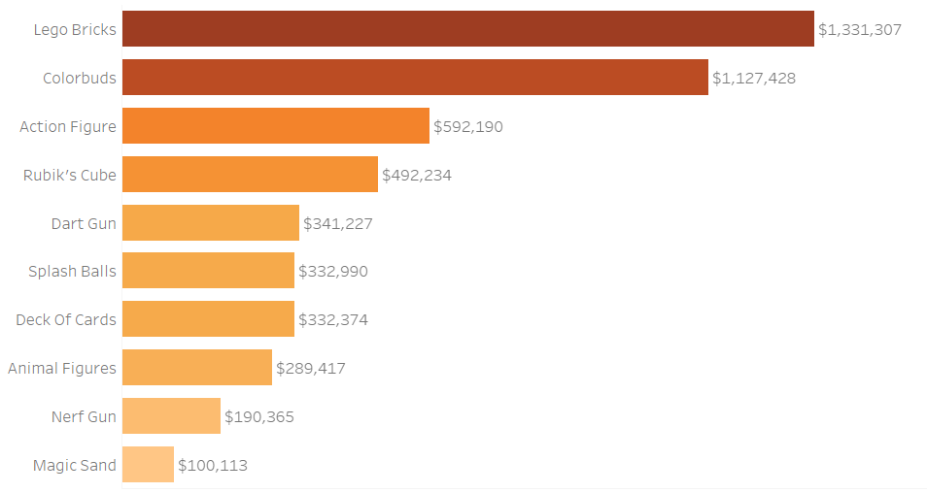
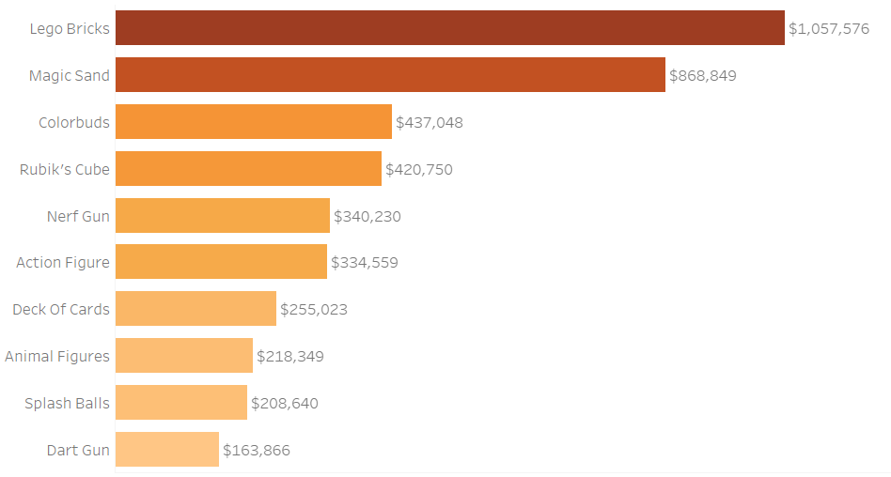
Key Findings
Top Products
By Sales:
2022: Lego Bricks ($1,331.3K), Colorbuds ($1,127.4K), Action Figures ($592.2K)
2023: Lego Bricks ($1,057.6K), Magic Sand ($868.8K), Colorbuds ($437.0K)

Slide 18
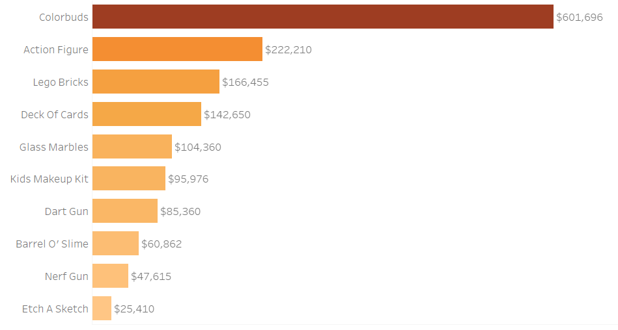
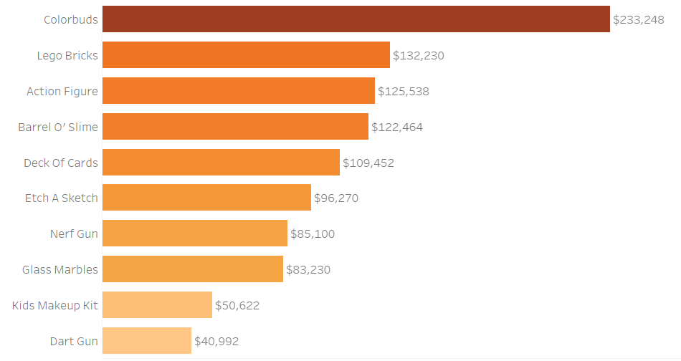
Key Findings
Top Products
By Profit:
2022: Colorbuds ($601.7K), Action Figures ($222.2K), Lego Bricks ($166.5K)
2023: Colorbuds ($233.2K), Lego Bricks ($132.2K), Action Figures ($125.5K)

Slide 19
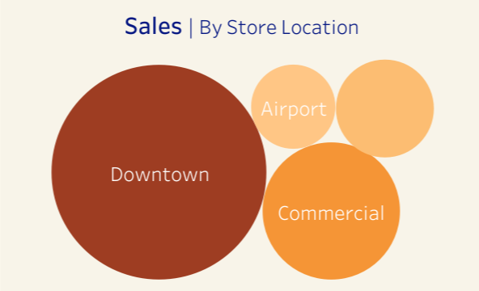

Key Findings
Store Location Performance
2022:
Downtown: $4.2M sales (56%) | $1,217.9K profit (55%)
Airport: $0.7M sales (9%) | $205.0K profit (9%)
2023:
Downtown: $4.0M sales (57%) | $1,030.8K profit (57%)
Airport: $0.6M sales (9%) | $173.0K profit (10%)
Insight: Downtown stores consistently dominated both years, accounting for over half of total sales and profit, though all locations saw slight declines.

Slide 20
Recommendations
High Priority
1. Focus on Growing Categories:
Action: Increase inventory and marketing efforts for Art & Crafts products to maintain their strong growth.
Impact: Adds an estimated $0.5M in annual sales, making Art & Crafts an even stronger contributor to the business’s success.
2. Electronics:
Action: Review and adjust the prices, introduce new products, and create marketing campaigns to improve Electronics performance.
Impact: Recovering just 10% of the profit lost in 2023 could bring in an extra $65K, helping to strengthen overall business profits.

Slide 21
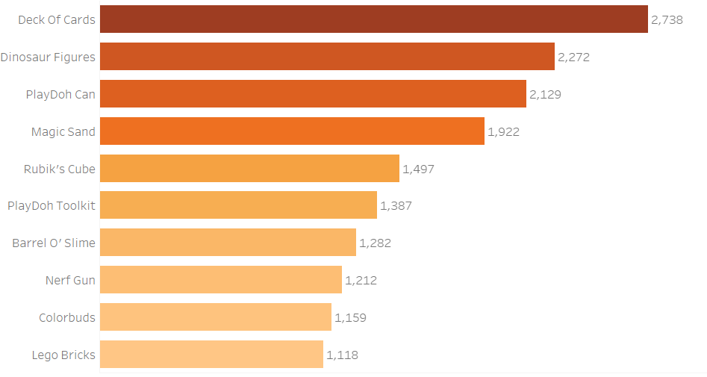
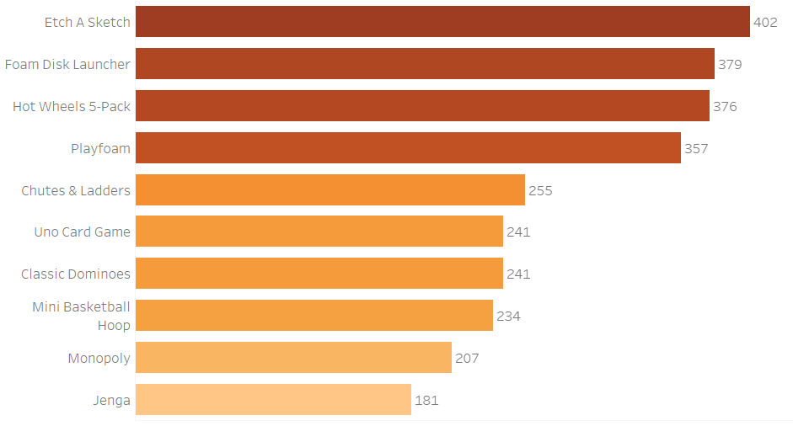
Recommendations
High Priority
3. Inventory:
Action: Align inventory levels with demand by reducing overstock for slow-moving items (e.g., Deck of Cards) and ensuring sufficient stock for high-demand products like Colorbuds, Lego Bricks, and Action Figures.
Impact: Improves cash flow by freeing up funds tied in unsold stock and reduces storage costs by minimizing overstock of slow-moving items.
“Top 10 products in Inventory”
“Least 10 products in Inventory”

Slide 22
Recommendations
Medium Priority
4. Expand Downtown Advantage:
Action: Introduce loyalty programs and targeted promotions at Downtown stores to further capitalize on their dominance.
Impact: Enhancing customer retention could add $0.3M to annual revenue.

Slide 23
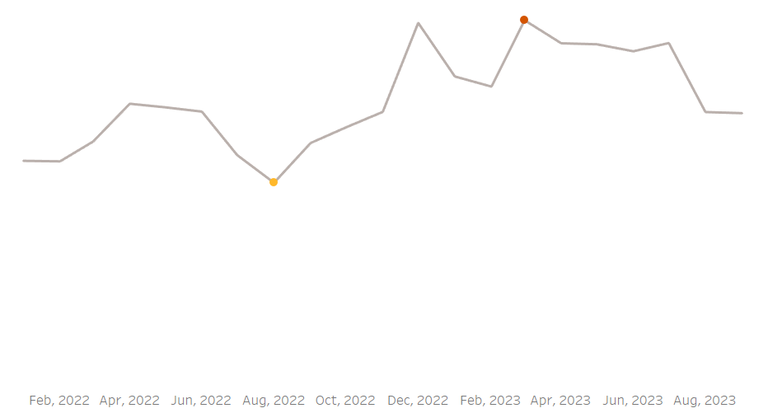
Recommendations
Medium Priority
5. Leverage Seasonal Trends:
Action: Use historical data to plan seasonal promotions, especially for Toys and Art & Crafts during holidays.
Impact: Targeted campaigns during these peak periods could drive a 5% increase in seasonal sales, translating to an additional $0.35M in revenue.

Slide 24
Recommendations
Low Priority
6. Investigate Underperforming Locations:
Action: Analyze customer feedback and operational challenges at Airport and Residential locations.
Impact: Identifying and addressing issues could stabilize these regions and prevent further declines.

Slide 25
Conclusion
The data reveals both challenges and opportunities:
High Priority: Targeting Art & Crafts growth, revitalizing Electronics, and optimizing inventory directly addresses the largest opportunities and challenges.
Medium Priority: Expanding Downtown advantages and leveraging seasonal trends builds on strong performance and captures peak demand periods.
Low Priority: Investigating underperforming locations stabilizes weaker areas without diverting focus from high-impact opportunities.

Slide 26
Thank
You

